Slide 1
Before we get started…
Go to www.github.com
Pick a username/password
Click the free option “unlimited public repositories”
Verify your email address
Create a new repository called “Automating-analysis”, and initialize with a README

Slide 2
Automating analysis in Stata
Scott Latham

Slide 3
Agenda
General programming advice
Version control
Making tables in Stata

Slide 4
Please indicate your level of familiarity with the following concepts:
Specific to Stata | I use that all the time | I use that sometimes | I know what that is but don't use it | I don't know what that is | I don't use that anywhere near as much as I should
Return codes [e.g. r(N), r(SE)]
Estout
Postfiling
Writing your own Stata commands
Using if statements on their own (rather than as modifiers)
Formatting macros & saved results
Double compound quotes
The pause command
Saving variable labels (for reshaping or for posting in a table)
General programming
Loops
Local/global macros
Escape characters
Building macros using loops
Utility functions
Version control

Slide 5
Please indicate your level of familiarity with the following concepts:
Specific to Stata | I use that all the time | I use that sometimes | I know what that is but don't use it | I don't know what that is | I don't use that anywhere near as much as I should
Return codes [e.g. r(N), r(SE)] | X
Estout |  | X
Postfiling | X
Writing your own Stata commands | X
Using if statements on their own (rather than as modifiers) |  | X
Formatting macros & saved results | X
Double compound quotes |  | X
The pause command | X
Saving variable labels (for reshaping or for posting in a table) | X
General programming
Loops | XXXXXX*
Local/global macros | XXXXXX*
Escape characters |  | X
Building macros using loops |  | X
Utility functions |  | X
Version control |  |  |  |  | X
*XXXXXXXXXXXXXXXXXXXXXXXXXXXXX

Slide 6
General programming advice

Slide 7
Tips for data work
Use (at least) two monitors!!!
Use naming conventions whenever possible
Separate fast and slow code, put slow code as near to the beginning of your project as possible
Organize code thematically into multiple .do files
E.g. data cleaning, descriptives, analysis

Slide 8
More tips
Invest time in commenting your code, but not so much that you won’t update it
Automate everything you can
Notes:
Commenting -> future you vs. someone else.

Slide 9
Abstraction
This is the source of our power as programmers!
Primarily means using macros/loops and writing your own Stata commands
Two reasons to abstract
Eliminate redundancy
Improve clarity
Otherwise, don’t abstract

Slide 10
Writing your own Stata commands
Used when you want to use the same bit of code over and over
Unlimited applications, we will talk about a few today

Slide 11
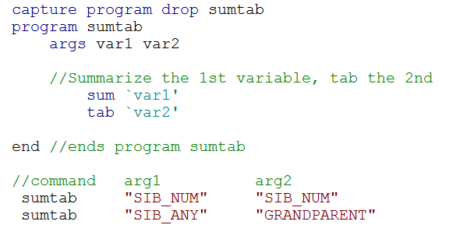
Writing your own Stata commands
Notes:
Args is short for arguments, that’s where you set the parameters of your Stata command. These arguments are strings, but you can use integers as well

Slide 12
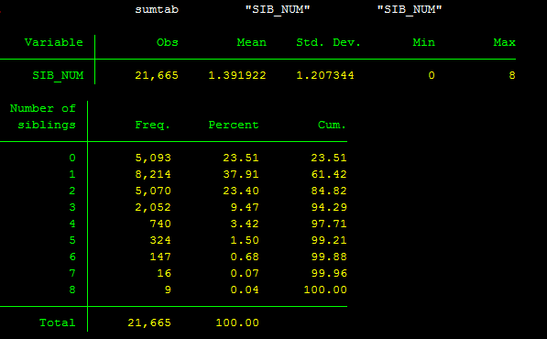
And when you run the command…

Slide 13
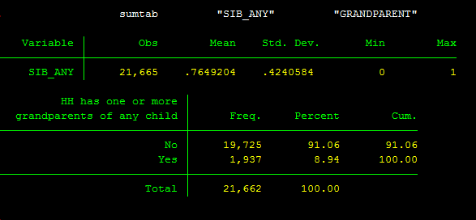
And when you run the command…

Slide 14
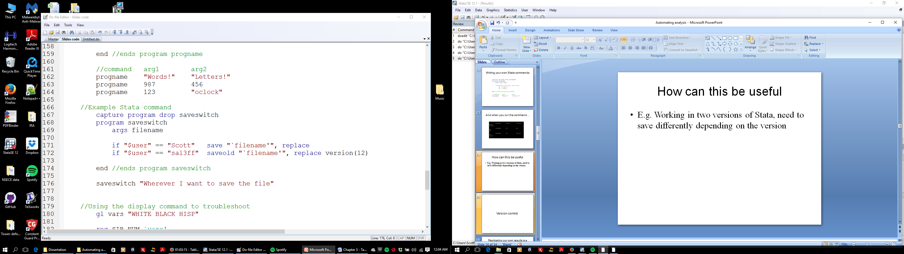
One useful example
E.g. Working in two versions of Stata, need to save differently depending on the version
Notes:
In this example, I’ve already set a macro called “user” that tells Stata which computer I’m using.

Slide 15
Version control

Slide 16
Replicating our own results is a constant frustration for researchers
We write complicated programs
We run our analysis many different ways
Sometimes we make changes that affect other parts of our code in unexpected ways
There are long gaps between when we first run the analysis and when we need to revise
If you can’t replicate your results..there’s really not much you can do

Slide 17
“Version control” can make huge inroads in solving this problem
Basic idea: Upload a snapshot of your work at a specific point in time to a server
You can then roll back to any snapshot you’ve uploaded
Notes:
Not a program, it’s a strategy for keeping track of how you arrived at all your estimates.

Slide 18
Uploading to the server
Click on your repository
Click “upload files”
Drag files where it tells you to
You also have to include a brief description of the changes you are making (e.g. “uploading tables”)
Click “commit changes”
Viola!
Notes:
Note: If you want to organize things into folders, I think you need to use GitHub Desktop, which you can download at https://desktop.github.com/
This is somewhat more complicated, and outside the scope of today, but I encourage you to spend some time with this on your own because it’s totally worth the investment

Slide 19
Version control does not fix everything!
Must be combined with good planning and attention to detail
Doesn’t guarantee that your code will work “right out of the box”

Slide 20
Sample procedure for versioning
Put all the files you need to run your code in a single folder
Delete all intermediate data files/tables/etc.
Run the master file start to finish
Compare to results you are submitting
Upload final tables/figures and syntax files to the server (no need to include intermediate files)

Slide 21
Making tables in Stata

Slide 22
The only 3 steps
1. Make Stata tell you what you want
2. Tell Stata to save it
3. Tell Stata to put it in a table
Notes:
Anything you could ever need to do can be sorted into one of these steps
Step 1 is mostly outside the scope of this mini workshop…we’re going to focus on steps 2 and 3.

Slide 23
Troubleshooting
Quickly locating and fixing code that is not working properly is an INVALUABLE skill
In table making there are 3 reasons your code can break:
You didn’t make Stata tell you
You didn’t tell Stata to save it correctly
You didn’t tell Stata to put it in a table correctly
…Sound familiar?

Slide 24
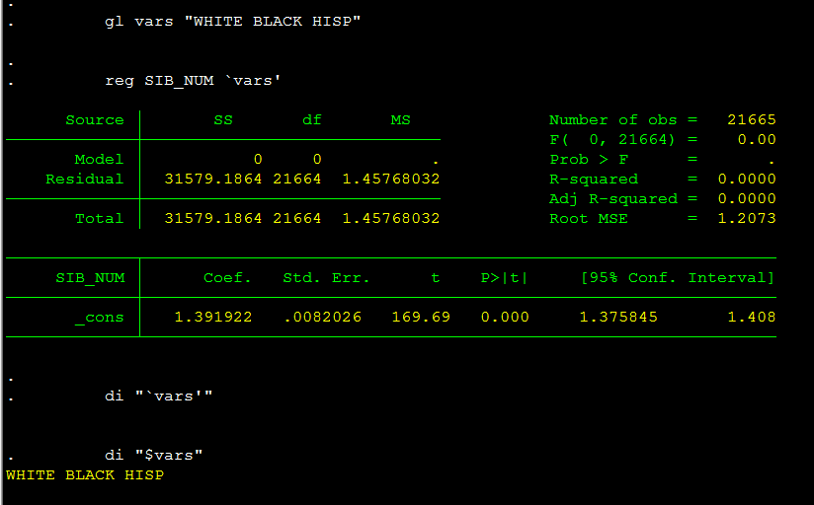
Use the display command to see what Stata sees

Slide 25
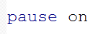
The pause command
Super useful tool for debugging your code
Does exactly what it sounds like
Must be turned “on” before you can call it
Only works as part of a .do file
Once paused, you can type “q” to proceed or “BREAK” (all caps) to stop the program

Slide 26
Stored values
Every time you run a command, Stata saves a bunch of information, called “stored” or “returned” values
You can view this info for descriptive commands by typing “return list”
For estimation commands, type “ereturn list”

Slide 27
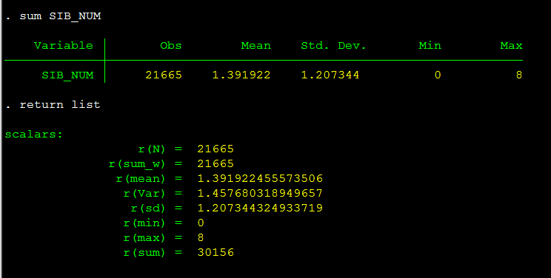
Stored values

Slide 28
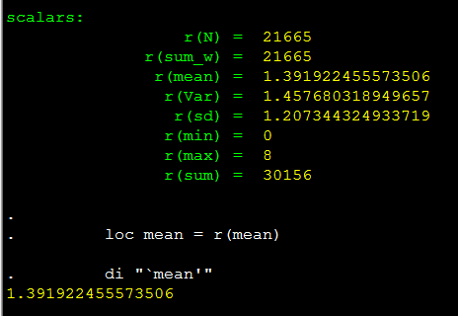
Tell Stata to save it
Stored values are overwritten as soon as you run a new command, so to use them, save them as macros

Slide 29
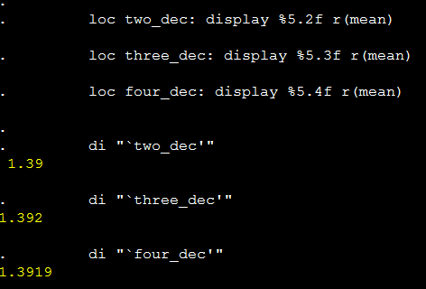
Tell Stata to save it
You can save rounded values by using the display command
Notes:
“%5.2f” tells Stata how to format the macro. For example 5.2 means a maximum of 5 total digits, including 2 to the right of the decimal

Slide 30
Put it in a table
Customized tables
Postfiling
Putexcel
Common table structures
User-generated commands (e.g. estout, outreg, tabout) are often the best option
Notes:
For the user-generated commands, all are viable options…it’s just about picking one and getting comfortable

Slide 31
Postfiling
An extremely flexible tool for making tables
Some startup cost to learning, but pays huge dividends
General idea: put all your saved results in a spreadsheet, one row at a time, then export the spreadsheet to Excel

Slide 32
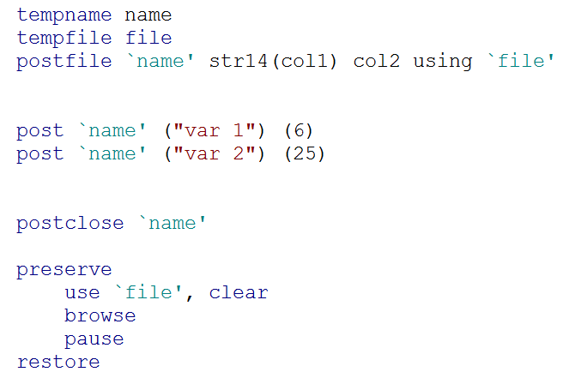
Postfiling seems intimidating…

Slide 33
…but it’s not so bad
These two lines set up temporary places to hold the table you’re building…you can copy them verbatim!

Slide 34
…but it’s not so bad
This line creates a new spreadsheet using the temporary name and file we just set up. It has 2 columns, the first is a string, and the second an integer

Slide 35
…but it’s not so bad
These two lines each post a row to the new spreadsheet. Note that entries must be in parenthesis, and strings must be in quotes

Slide 36
…but it’s not so bad
This tells Stata I’m done adding new rows to the spreadsheet

Slide 37
…but it’s not so bad
And this lets me take a peek at the spreadsheet I just created

Slide 38
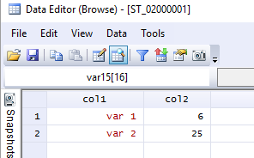
Once you have the table you want, you can just export it into Excel

Slide 39
Problems 1 & 2

Slide 40
Indicating significant differences with postfiling
Unfortunately, a little complicated
Fortunately, you’re all very smart ☺
Have to save macros indicating significance stars (i.e. *, **, ***)
Example: We want to indicate whether children of pre-k age are more likely to be in non parental care than infants/toddlers

Slide 41
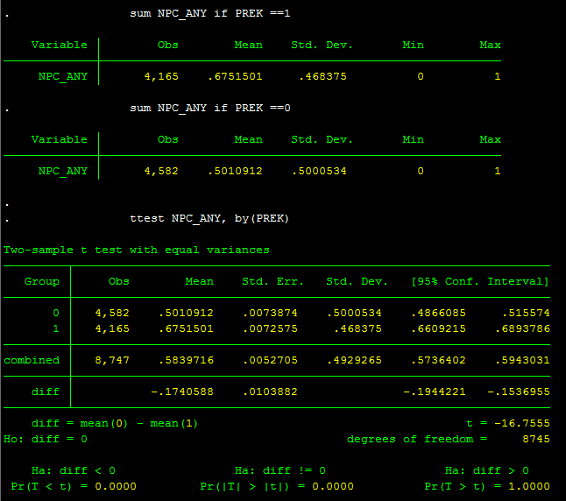
Now we see the answer we want, we just need to save it. Luckily, Stata has done part of the work for us….
Notes:
Here, you need to have a dummy variable that you can use for the t-test

Slide 42
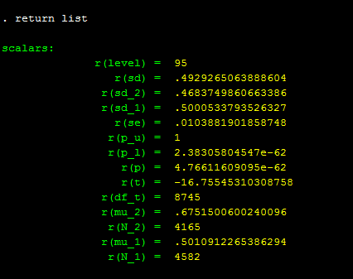

Slide 43
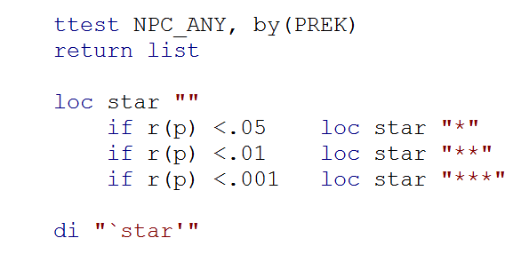
Create star values from stored p values
Notes:
We add the display command at the bottom to test whether it is working correctly

Slide 44
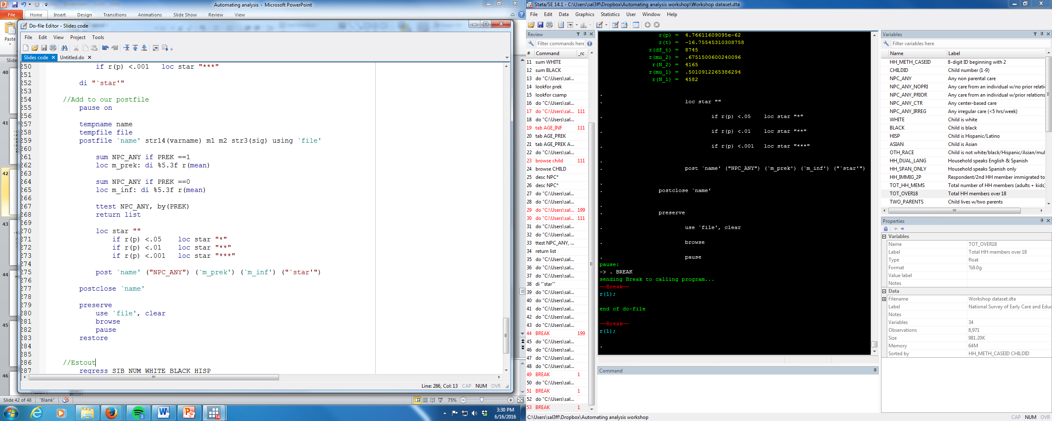
Adding into a postfile

Slide 45
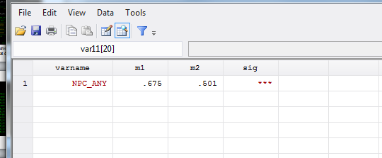
And here’s the result
Notes:
From here, it’s relatively straightforward to write a loop that will show analogous descriptives for any variables you want

Slide 46
Problem 3

Slide 47
Putexcel
Another great option for making customized tables
Basic idea: Build a matrix and then export it into Excel
Allows a bit more flexibility in how you build tables (e.g. top-to-bottom, left-to-right), but is a bit more challenging to automate the inclusion of text
Unfortunately, beyond the scope of today, but definitely worth looking into on your own
Notes:
There is a lot of overlap in the tools you need to use postfiling and putexcel, so your effort in learning postfiling is not wasted if you plan to switch to putexcel or vice versa!

Slide 48
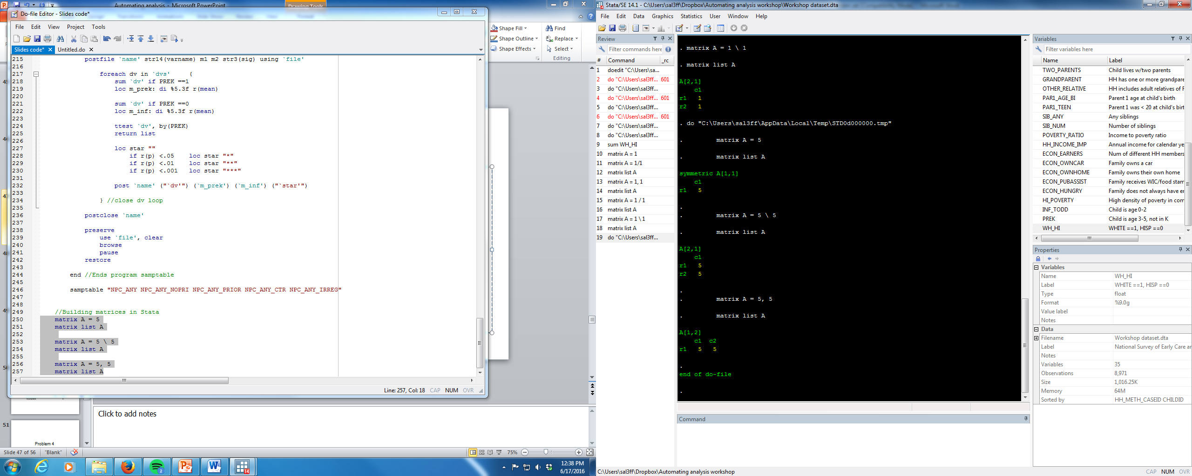
Building matrices in Stata
Backslash indicates “next row”
Comma indicates “next column”

Slide 49
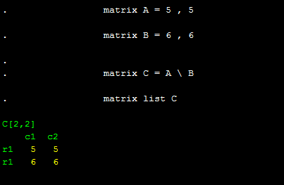
It’s easy to combine matrices

Slide 50
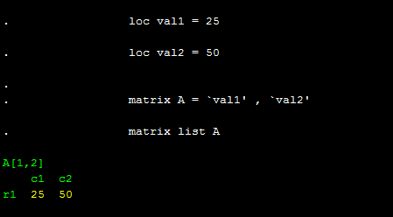
Or build them using macros

Slide 51
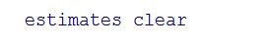
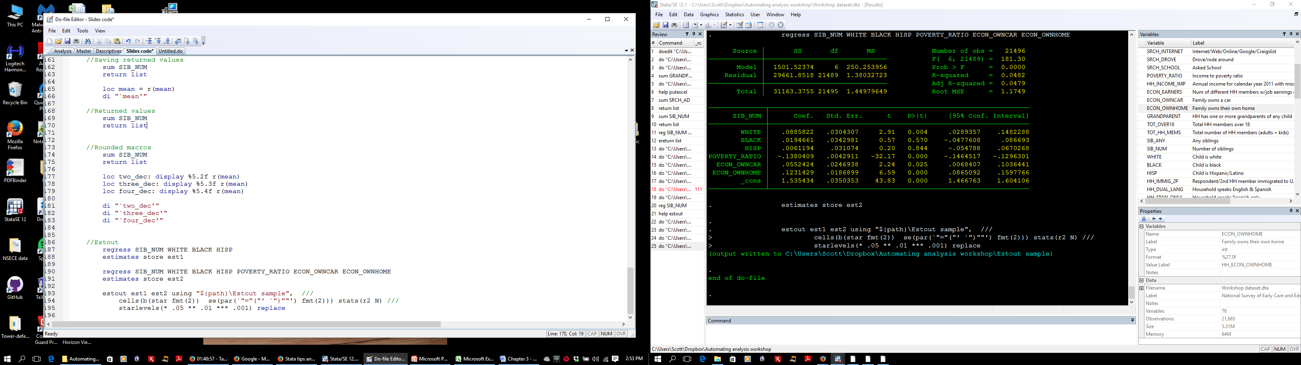
Estout
User generated command
Great for tables that show a sequence of regressions with differing controls
Notes:
There are a ton of bells and whistles included in this estout command. They are mostly fairly straightforward, though may take some time to parse out

Slide 52
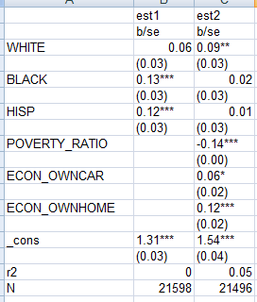
Here’s what is exported into Excel

Slide 53
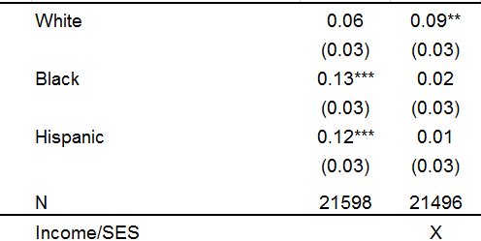
And with a little love…

Slide 54
Problem 4

Slide 55
Writing your own commands to make tables
When working on a research project it’s common to run virtually the same analysis many times, with slight alterations
This is the perfect time to write your own Stata commands!
You can build flexibility into these commands any way you want by adding new (e.g. in terms of outcomes, samples, weights, controls, etc., etc., etc.)
Notes:
You can think of a Stata command as a “deluxe loop”

Slide 56
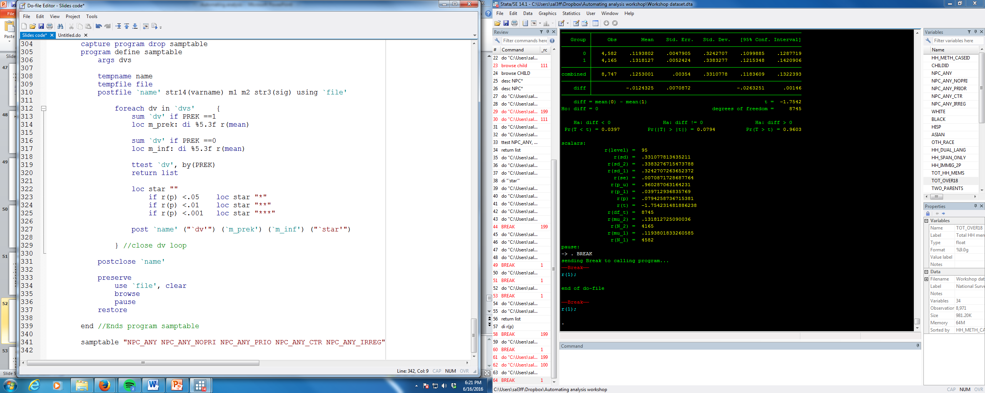
Notes:
Now we have a Stata command that will show us descriptive statistics separately by age for any set of variables we want.

Slide 57
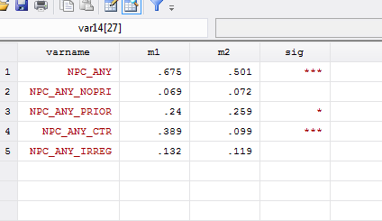

Slide 58
Other tips for making tables
Start simple, and build complexity as you go
You will always do more analysis than you initially expect, so it helps to err on the side of making your code overly flexible
If you’re building a multi-panel table, it often makes sense to create each panel separately
Save a formatted version of your tables in Excel and then use “paste special” so you only have to format each table once
Notes:
Another benefit of having flexible code is you will be able to produce and examine more analysis in general, and you’ll get a better sense of your data

Slide 59
Problems 5, 6, & 7

